Slide 1
Semantic Technologies for Expert Search
The OWLsome Team
Ines Bannour
Alexandra Roatis
Jon Lazaro
Jean-Philippe Fauconnier
Johann Wanja Schaible

Slide 2
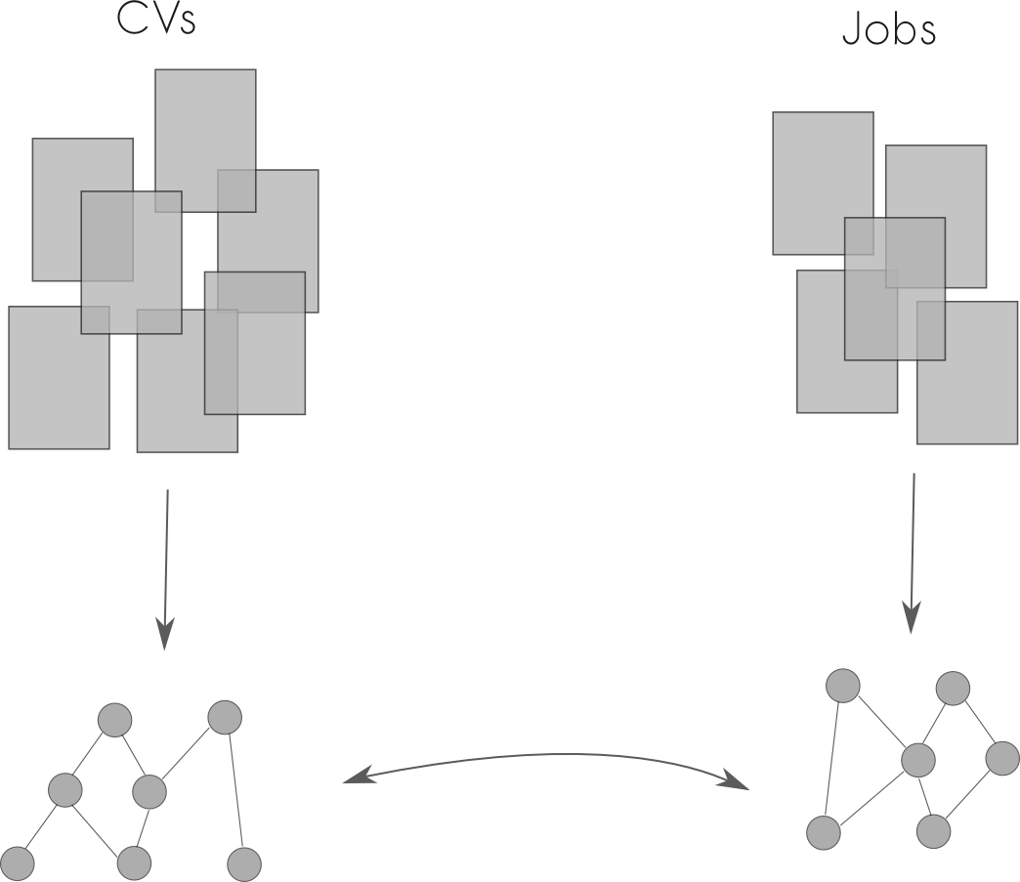
Motivation
?

Slide 3
The Matching Model
Conditions c_{i}:
Inferred from personal CV
Based on knowledge base
Provided by person
Preferences x_{j}:
Provided by job offer
Provided by the user
The calculation method for the similarity depends on the feature p.
Graph based calculations
Taxonomies
Scales
Ontologies
LOD

Slide 4
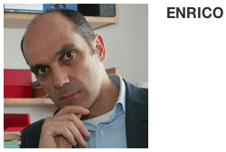
Occupation
Professor
Assistant professor
Occupation hierarchy
Post-doc
Ph.D. student
Master student

Slide 5
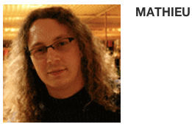
Location
Distance between locations is calculated by geo coordinates taken from DBPedia.
Information on local facilities is also taken from DBPedia

Slide 6
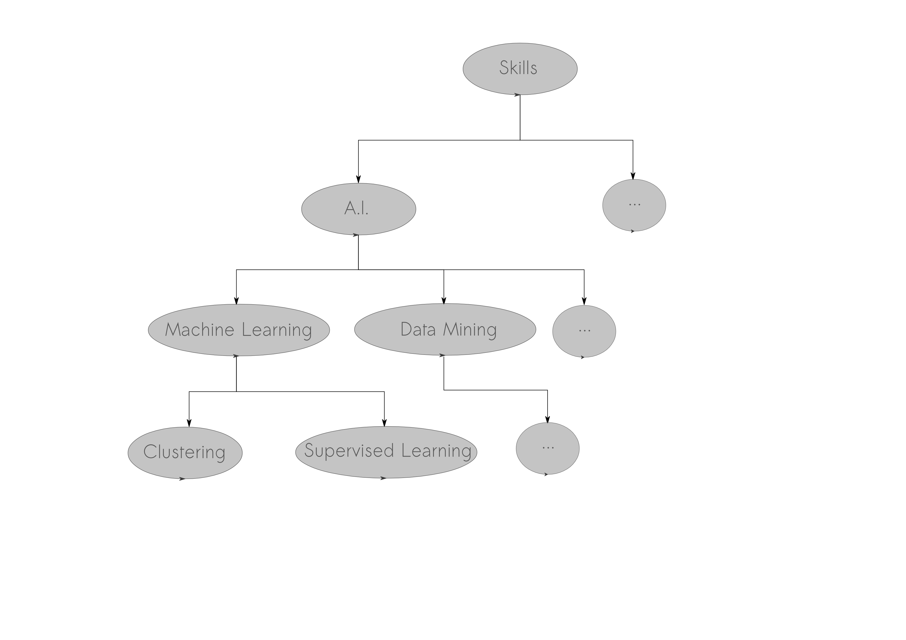
Skills

Slide 7
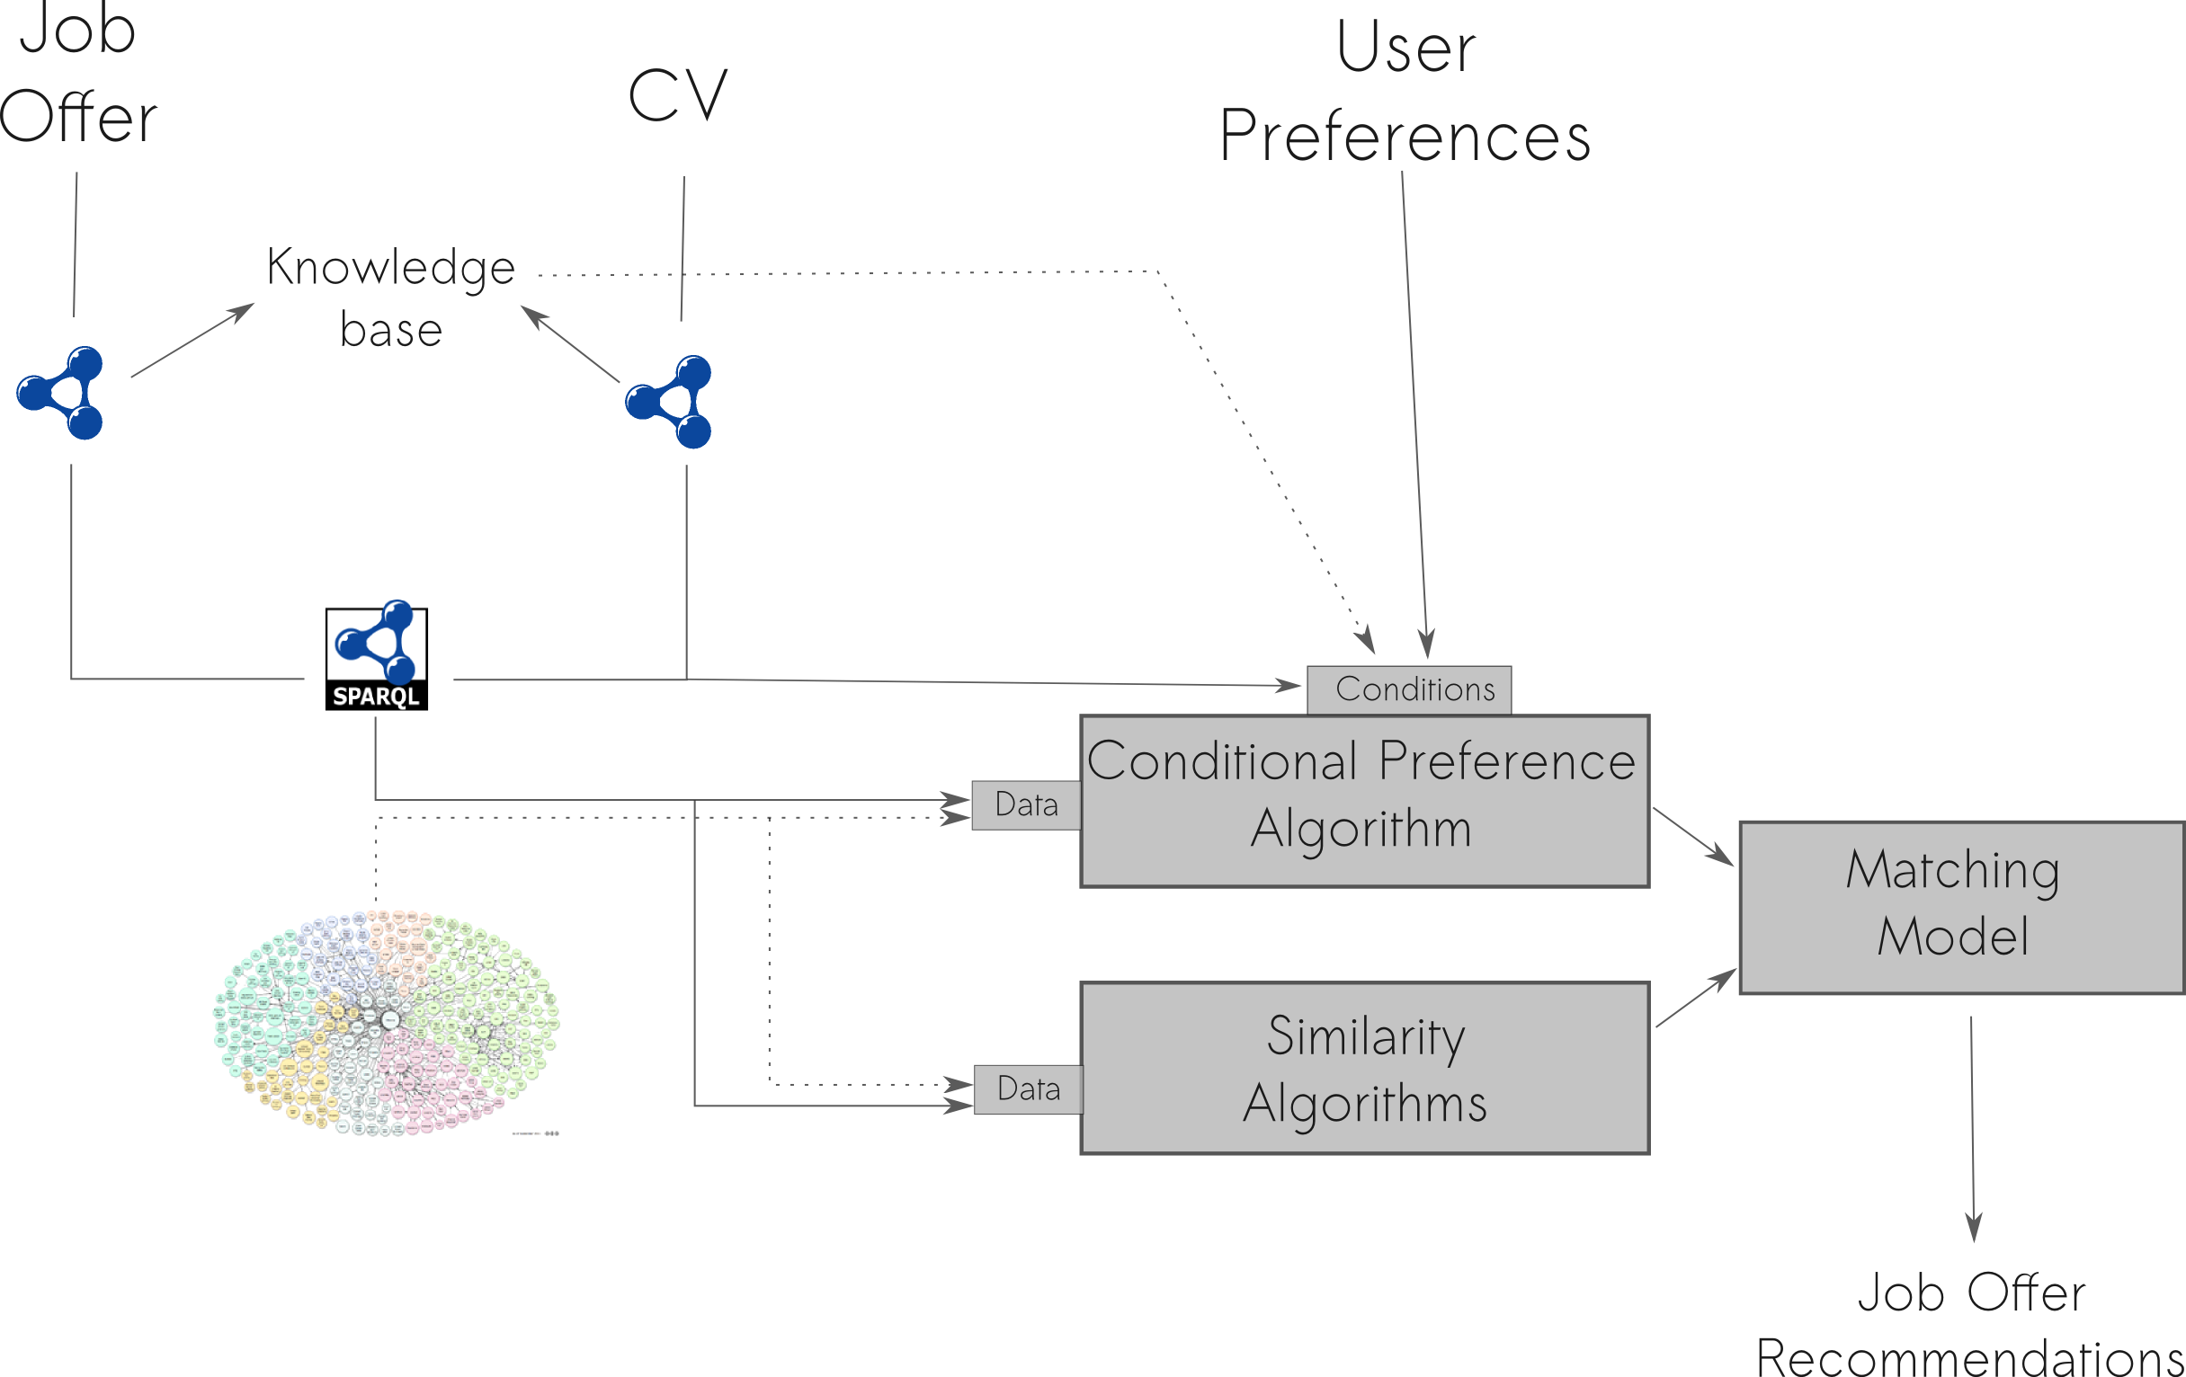
Architecture

Slide 8
Evaluation
Live Performance

